Slide 1
Choose the best Neighborhood
Freiburg, Germany

Slide 2
Objective
Collecting the school ranking note and do the comparison
Collecting the house price and do the comparison
Collecting Neighborhood’s top trending venues using Foursquare API(Beautiful Soup, http request
Identifying and understanding the similarities and dissimilarities between two chosen neighborhoods to retrieve more insights and to conclude with ease which neighborhood wins over other.

Slide 3
Python packages and Dependencies:
Pandas - Library for Data Analysis
NumPy - Library to handle data in a vectorized manner
JSON - Library to handle JSON files
Geopy - To retrieve Location Data
Requests - Library to handle http requests
Matplotlib - Python Plotting Module
Sklearn - Python machine learning Library
Folium - Map rendering Library

Slide 4
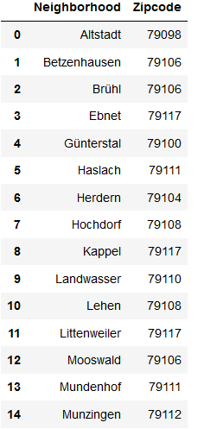
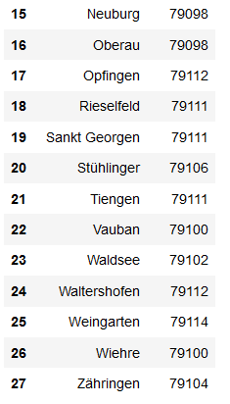
List of neighborhoods in Freiburg – extract from html

Slide 5
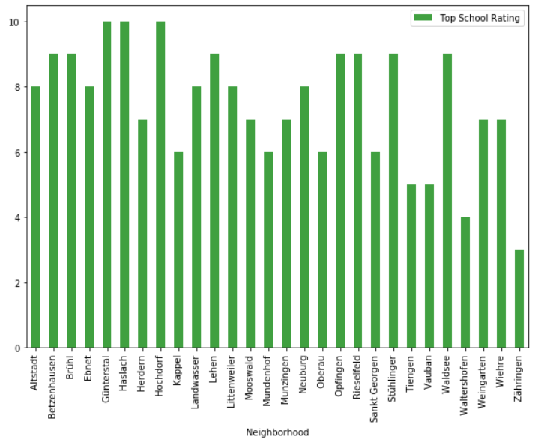
School ratings plot

Slide 6
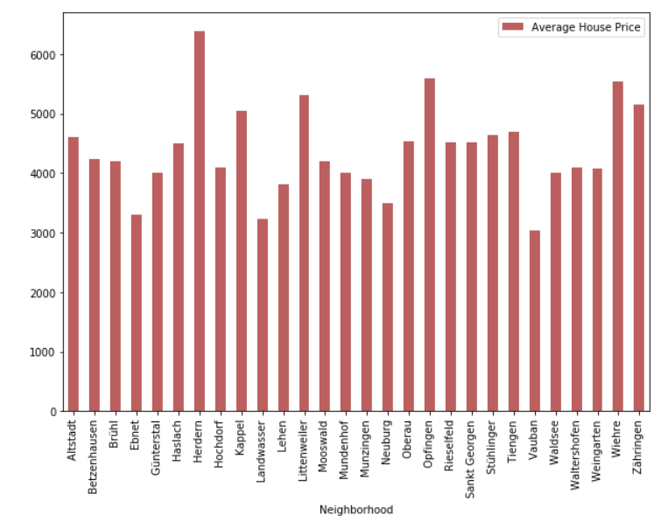
Average housing price plot

Slide 7
Comparison between Neighborhoods
Haslach and Rieselfeld
Now lets compare 2 neighborhoods to choose one that best matches our requirements as given below
1. Higher School Rating
3. Cheaper House Price
4. Comfortable Neighborhoods

Slide 8
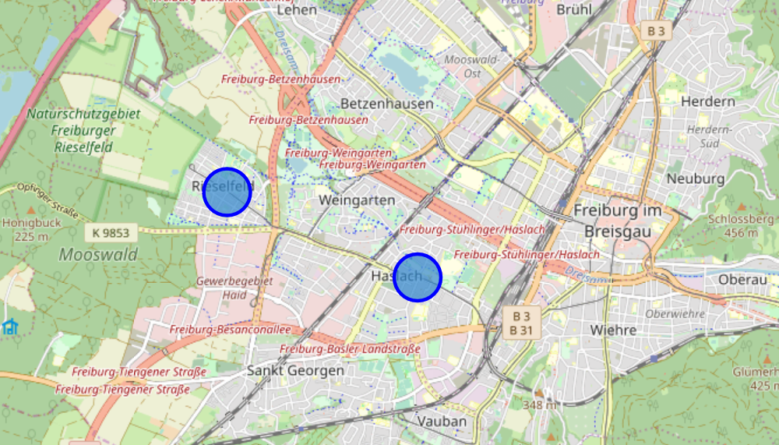
The two chosen neighborhoods – folium map

Slide 9
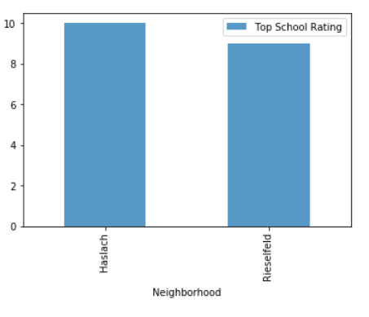
School ratings

Slide 10
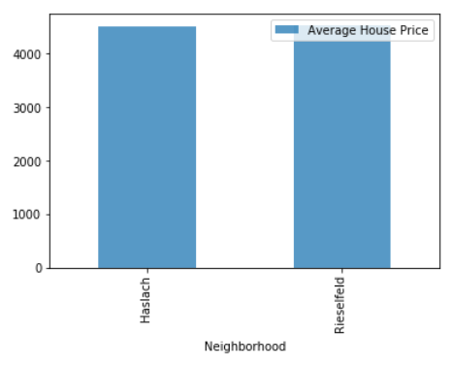
Average housing price

Slide 11
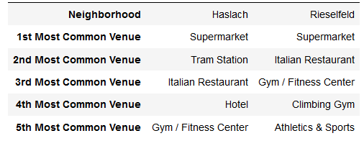
Neighborhood Venues

Slide 12
Conclusion
This Analysis concludes that compared to Rieselfeld,
Haslach has higher the school ranking
the house price is cheaper
the public traffic is more convenient in Haslach.
But the differences are not huge, you can choose Rieselfeld if you enjoy doing sports.

Slide 13
Thank you

